Slide 1
British Airways
Customer ratings analysis and insights

Slide 2
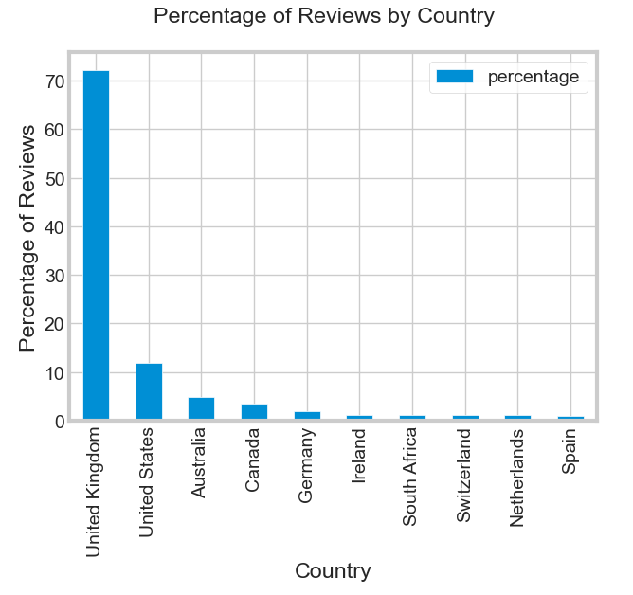

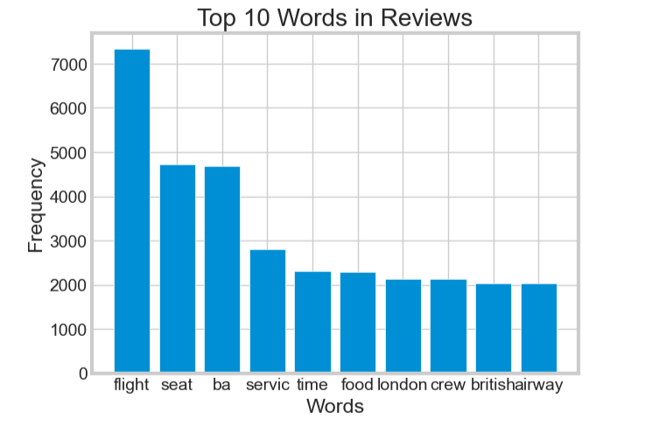
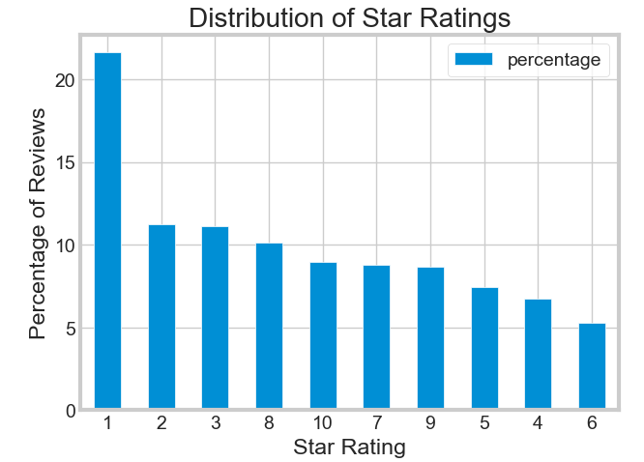
KEY METRIC
Average Rating 4.8/10 for 3469 data
Reviews from 69 Countries
3469 Data Collected
average of 10 countries writing the most reviews: saints kitts and nevis, Oman And Laos and so on as in the bar chart
data distribution by rating average percentage rating 1 with 21.6%, rating 2 with 11.24% while rating 10 with 8%
the average percentage of countries that write reviews british airways united kingdom tops the list with 72% of reviews.
The 10 words that appear most often in reviews, with flight, seat and ba

